Slide 1



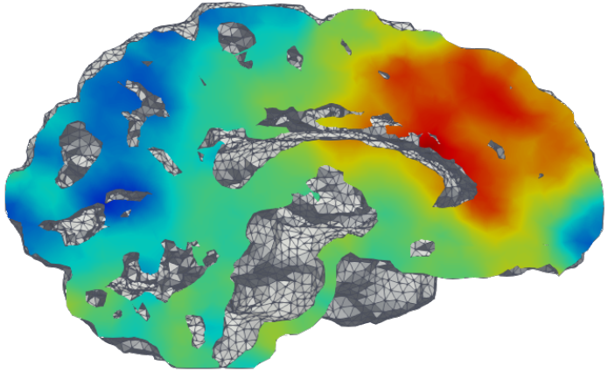
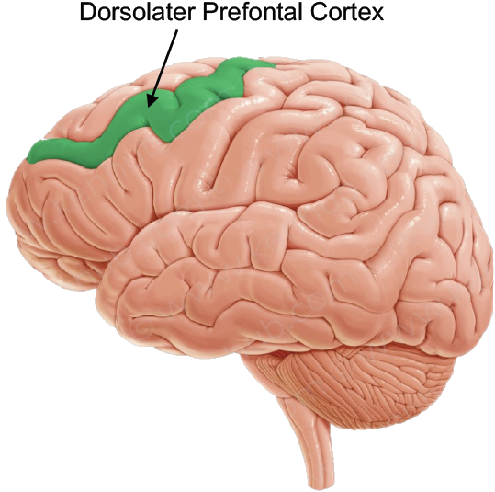
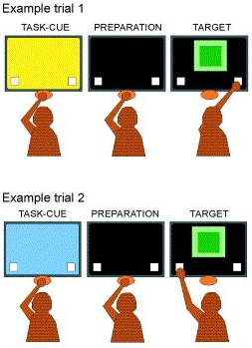
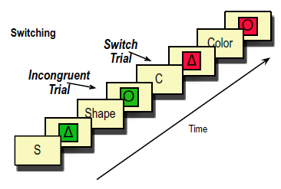

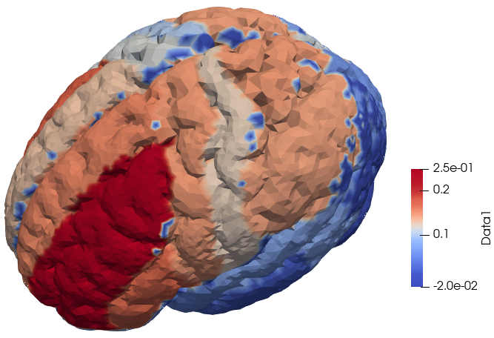


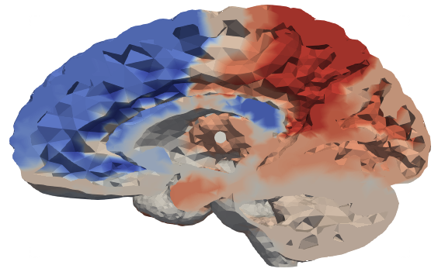
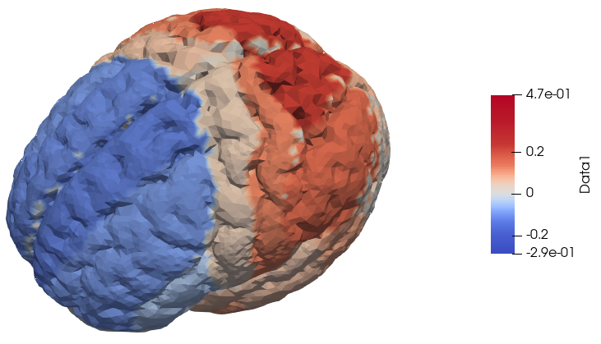
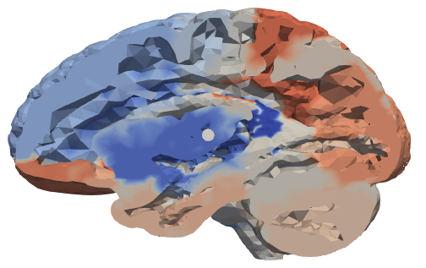
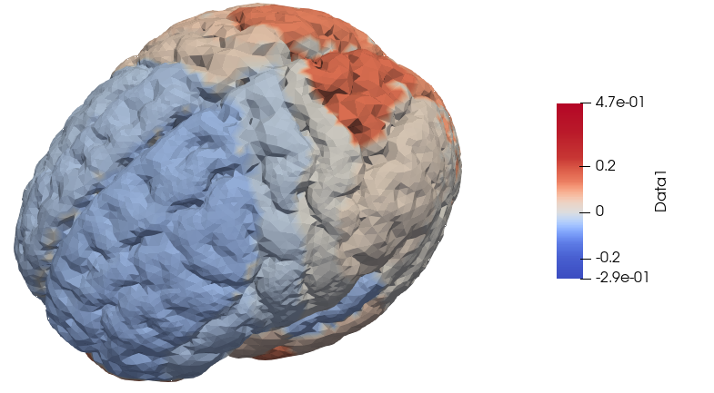

Study case on Human Brain Connectivity: Task-Switching in Schizophrenia Costanza Cantalini, Erica Bistacchia, Lorenzo Ferrara, Scott Pesenti
Presentation of the problem and our aim
Our experiment
Our dataset
One of the regions hindered by schizophrenia is the dorsolateral prefrontal cortex (DLPFC) which has been associated to the ability of task switching (TS). Nevertheless, literature suggests that people affected by schizophrenia (SCHZ) do not perform worse than a neuro-typical control population (CTRL). Apparently SCHZ are simply slower in TS, but reach the same tasks’ performances of CTRL. The literature assumes that this latter fact is possibly due to some unknown compensation mechanism in the SCHZ’s brain.
The objective of our project was an exploration of the differences in brain activity between SCHZ and CTRL during TS. To this end we consider the results of the 175 participants subjected to the following test.
The data considered for this work came from an experiment involving 175 participants (125 CTRL and 50 SCHZ). They provided general pieces of information like health, age, BMI, possible comorbidities, smoking habits, and behavioral traits (quantified through the Barratt Impulsivity Test).
While under fMRI, each participant was presented with a series geometric shapes and asked to identify either the color or the shape of the image, based on the task cue presented prior to the image.
On 25% of trials the instructions switched, i.e. participants were instructed to switch from identifying shape to identifying color, or vice versa.
Sometimes there was congruency, that is the correct response to the trial was the same using both the new and the old criterium.
We also have information about the correctness of their responses.
Consequently, three sets of data were gathered for each participant:
Covariates, which included all the health-related data.
Z-map, a table of >36000 values, each corresponding to a node of the brain mesh on which the fMRI data was projected
Event recordings, a time step dataset composed of all the readings from the test, such as: reaction time, cue, answer.
In particular, we kept only age and BMI among all the covariates data, as the other ones were mainly missing or not consistent.
Preliminary exploration of the dataset
We checked whether the data basic statistics matched the literature and we identified the regressors that are statistically significant w.r.t. reaction time:
BMI AGE
General difference
PSYCHOLOGICAL TRAITS, BARRATT IMPULSIVENESS SCORES
We performed a t-test on the means confirmed a significative difference in the distributions of the Reaction Times in CTRL and SCHZ
ABBIAMO UN PVALUE DEL 6.266e-13
We performed a t-test on the Scores of the Barratt Impulsivity Test (BIS) confirmed a significant difference between the means of SCHZ and CTRL scores (see Fig. 2).
Abbiamo un pvalue ≈ 1
And then we proceeded using the following Linear Regression Models (LRM)
Reaction.Time ~ BIS.
But BIS did not turn out a statistically significant regressor, despite the previous results of the T-test on the BIS scores.
Finally we explored the relation between health covariates and Reaction times using the LRM:
Reaction.Time ~ Age + BMI + Diagnosis + Age:Diagnosis + BMI:Diagnosis
Only age and Diagnosis resulted as the only statistically significant regressors (see Fig 5) and no interaction seems to be important.
Analyses of the performances
ANOVA
PRINCIPAL COMPONENT ANALYSIS
CONCLUSIONS
The performance of each participant is measured through the following four indexes (see Fig.9867):
Switch cost: $μ$_{Switch} – $μ$ _{noSwitch} = mean time during switch trials - mean time during nonswitch trials
Correct cost: $μ$_{Correct} - $μ$_{nonCorrect} = mean time during correct trials - mean time during noncorrect trials
General accuracy rate: #correct/#total
Switch accuracy rates:
#errors_on_Switch/#total_Switch
#errors_on_Switch/#total
The analysis of the available dataset and of the above four indexes was performed as follows:
we carried on an analysis of the Switch Costs and Correct Costs,
an ANOVA
an analysis of error/accuracy rates.
An ANOVA on the mean of the reaction times of each participant according to different conditions of the experiment:
Reaction.time ~ diagnosis + congruent + switch + diagnosis*congruent + diagnosis*switch + congruent*switch
showed a high significance of diagnosis and switch, but no interaction was statistically significant. A stepwise reduction led us to the additive model:
Reaction.time ~ diagnosis + switch (see Fig. 46).
f
f
f
f
f
f
f
f
f
f
The TEAM
QUALE METTIAMO
DA SCRIVERE MEGLIO Paired with the results from the LRM in the preliminary analysis and the Box Plots in the analysis of switch costs we can state that the difference between Switch Costs for SCHZ and CTRL are not statistically significant, switching seems not to hinder SCHZ’s reaction time more than CTRL.
Analyses of the Switch Costs and Correct Costs
VORREI METTERE DELLE FRECCINE O DELLE ETICHETTE PER I NOMI DELLE REGIONI
LMM
f
f
f
f
f
f
f
f
f
f
We have checked whether the covariates related to the trials' conditions influenced the reaction times.
We started from an ANOVA model (reaction.time ~ diagnosis + switch + congruent) to discriminate the four different kinds of trial conditions (Switch-Congruent, Switch-nonCongruent, nonSwitch-Congruent, nonSwitch-nonCongruent), but of course the data related to the same subject are not independent.
=> therefore we used the subjects' grouping as a Random Effect in a Linear Mixed Model (see Fig. 4358)
reaction.time ~ diagnosis + switch + congruent + (1|Subject)
The corresponding PVRE resulted extremely high (VALORE=0.8483049), suggesting that most of the real variability must be assigned to the intrinsic differences between participants rather than the difference between two groups (see Fig. 45672).
The analyses of the performances falsify the hypothesis under concern as it appears that no compensating mechanism is present. The accuracy rate of SCHZ is lower than CTRL but seems independent of task switching, this fact may occur because SCHZ are afflicted by a general impedance in the working memory which would make each trial independent of the previous one.
[PCA pending]
The high value of the PVRE indicates that the mean of the population isn’t statistically significant for the single individual as most of the variability is explained by the intrinsic difference between participants
Performing a test on the mean of the swtichcost we get a very high pvalue (p=0.4643)
dovremmo mettere vicini i due blu e i due arancioni?
f
f
f
f
f
f
f
f
f
f
Performing a test on the mean of the swtichcost we get a very high pvalue (p = 0.5299)
CONSIDERATIONS ABOUT ACCURACY
The box-plot in the left shows that of course CTRL have higher accuracy.
The box-plots in Fig. 4782 on the right indicate that both the differences in accuracy rate and accuracy on switch between CTRL and SCHZ are statistically significant. In particular, the SCHZ accuracy rate is lower than the CTRL one. On the other hand, the SCHZ accuracy on switch is higher than the CTRL one.
In addition, the same Box plots also indicated that the differences in accuracy rate and accuracy on switch of CTRL is statistically significant. This fact does not hold true for the SCHZ.
The previous results falsifies what has been proposed in literature. It appears that no compensating mechanism is necessary as the accuracy rate of SCHZ is lower than CTRL but seems independent of task switching.
f
f
f
f
f
f
f
f
f
gù
g
f
BIBLIOGRAPHY
Susan M. Ravizza, Cameron S. Carter, Shifting set about task switching: Behavioral and neural evidence for distinct forms of cognitive flexibility, Neuropsychologia 46 (2008) 2924–2935
Susan M. Ravizza, K.C. Keur Moua, Debra Long, Cameron S. Carter, The impact of context processing deficits on task-switching performance in schizophrenia, Schizophrenia Research 116 (2010) 274–279
Alina Gomide Vasconcelos, Leandro Malloy-Diniz, Humberto Correa, SYSTEMATIC REVIEW OF PSYCHOMETRIC PROPRIETIES OF BARRATT IMPULSIVENESS SCALE VERSION 11 (BIS-11), Clinical Neuropsychiatry (2012) 9, 2, 61-74
Nachshon Meiran, Joseph Levine, Naama Meiran and Avishai Henik, Task Set Switching in Schizophrenia, Neuropsychology 2000, Vol. 14, No. 3, 471-482
Rotem Leshem, Relationships between trait impulsivity and cognitive control: the effect of attention switching on response inhibition and conflict resolution, Cogn Process (2016) 17:89–103
Glenn R. Wylie, E. A. Clark, P. D. Butler and D. C. Javitt, Schizophrenia Patients Show Task Switching Deficits Consistent With N-Methyl-DAspartate System Dysfunction But Not Global Executive Deficits: Implications for Pathophysiology of Executive Dysfunction in Schizophrenia, Schizophrenia Bulletin vol. 36 no. 3 pp. 585–594, 2010
Fred W. Sabb, Gerhard Hellemann, Nicholas B. Allen, Carrie E. Bearden, Enhanced switching and familial susceptibility for psychosis, Brain and Behavior. 2018;8:e00988
S. Jamadar, P. Michie, F. Karayanidis, Compensatory mechanisms underlie intact task-switching performance in schizophrenia, Neuropsychologia 48 (2010) 1305– 1323
Dara S. Manoach, Kristen A. Lindgren, Mariya V. Cherkasova, Donald C. Goff, Elkan F. Halpern, James Intriligator, and Jason J.S. Barton, Schizophrenic Subjects Show Deficient Inhibition but Intact Task Switching on Saccadic Tasks, BIOL PSYCHIATRY 2002;51:816–826
Paul D. Kieffaber, Emily S. Kappenman, Misty Bodkins, Anantha Shekhar, Brian F. O’Donnell, William P. Hetrick, Switch and maintenance of task set in schizophrenia, Schizophrenia Research 84 (2006) 345–358

